Slide 1

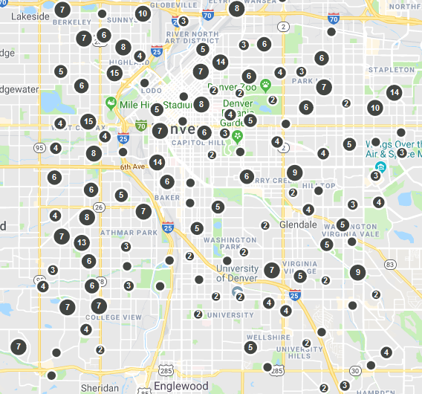
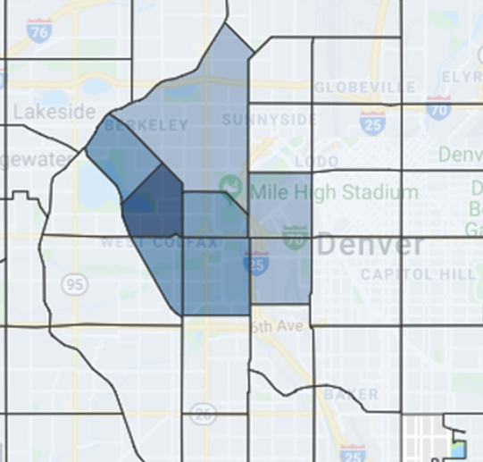
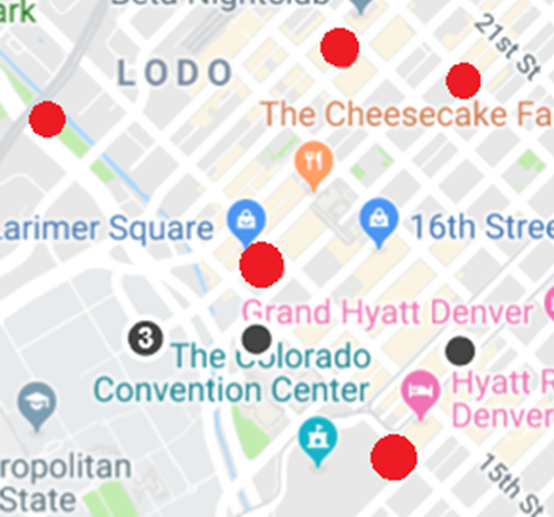
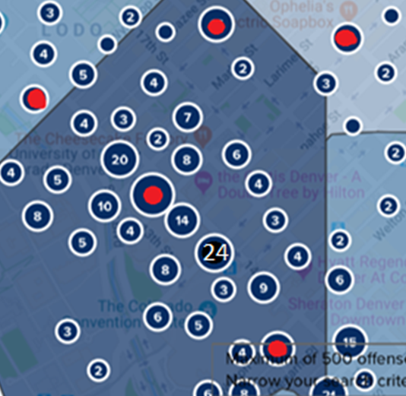
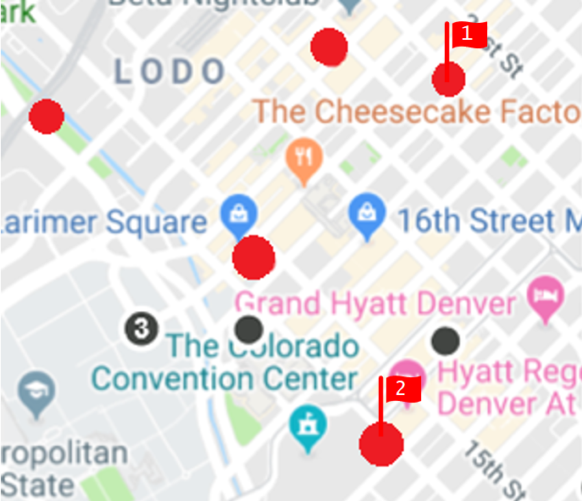
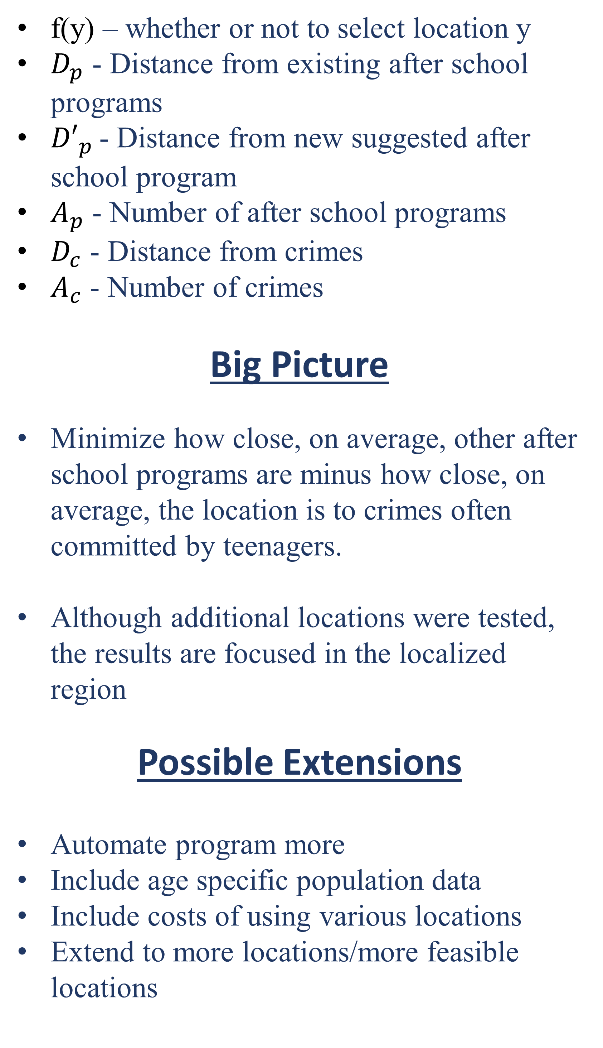
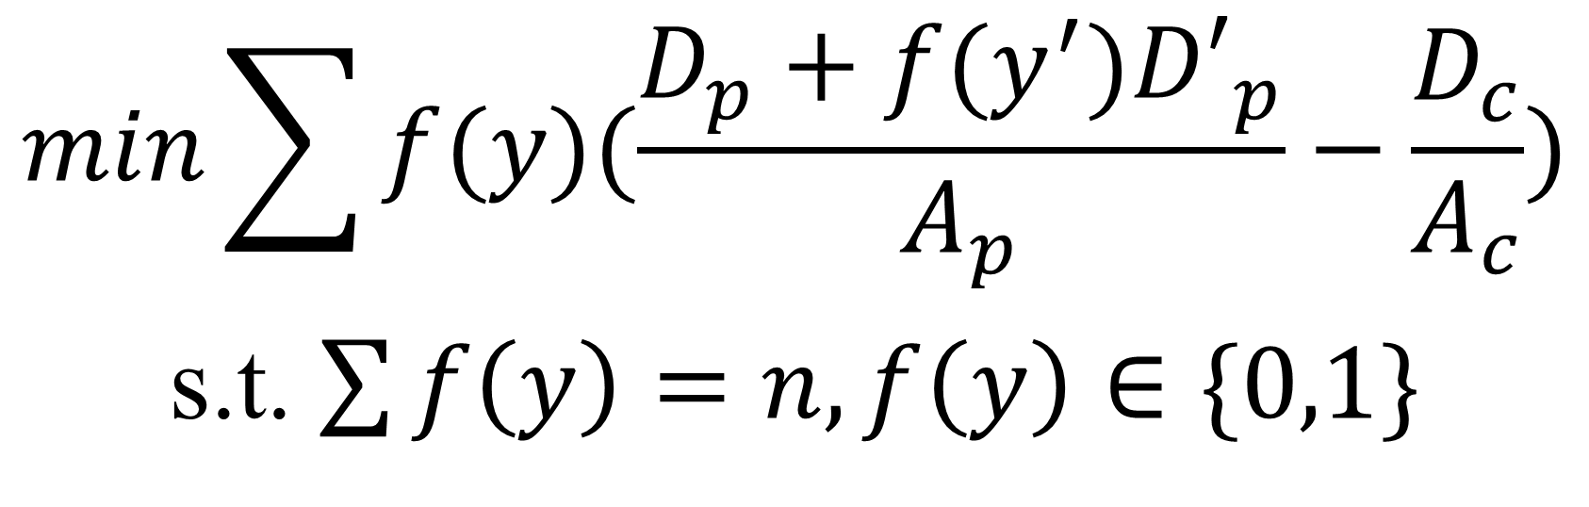
Using After School Programs to Reduce Crime Rates
Connor Mattes and Zachary Sorenson
Motivation and Overview
Visualizations and Methodologies
Integer Linear Program
Being both educators and students, Connor and Zach wanted to look into how educational resources can be used to positively influence their community. Given the tools and resources we had, we decided to investigate after school programs.
This project developed a linear program that maximized the effectiveness for the placement of programs. We decided to focus on the the data for the location of crimes that are most often committed by teenagers for 2014 in Denver. From this information, we decided the optimal locations for after school programs for various integer amounts.
Big Picture
$$min\sum{f(y)(\frac{D_{p}+f(y^{′}){D′}_{p}}{A_{p}}−\frac{D_{c}}{A_{c}})}$$
s.t. $\sum{f\left(y\right)=n, f\left(y\right)∈\{0,1\}}$
After School Programs in Existence
Location of Crimes
f(y) – whether or not to select location y
$D_{p}$ - Distance from existing after school programs
${D′}_{p}$ - Distance from new suggested after school program
$A_{p}$ - Number of after school programs
$D_{c}$ - Distance from crimes
$A_{c}$ - Number of crimes
Big Picture
Minimize how close, on average, other after school programs are minus how close, on average, the location is to crimes often committed by teenagers.
Although additional locations were tested, the results are focused in the localized region
Possible Extensions
Automate program more
Include age specific population data
Include costs of using various locations
Extend to more locations/more feasible locations
Localized Region
After School Programs in Focused Location
Location of Crimes In Focused Area
Methods/Software Used
AMPL and CPLEX
Excel
Open Refine
MAT 5593 Linear Programming (Steffen Borgwardt)
epsg.io – for transforming coordinates
Google Maps
Results
Generalizations
Crime 2+ miles away from potential after school program were not used in calculation
Crimes that were within ~5 ft - ~2 blocks away from an afterschool program were considered to be equivalent distance
Only general locations are recommended. We leave the specifics of the actual location (rent, type, size) to the policy makers
Top 2 Locations:
1947 Lawrence Street, Denver CO 80202
700 14th Street, Denver CO 80202
Sources
“TOP 25 Types of Referrals Crimes, Offenses and Violations Youth/Teen/Student/Peer Court”,
https://www.globalyouthjustice.org/resources/top-25-crimes/ © 2018 Global Youth Justice
Data Sets:
“After School Programs,” Locations of varied programs
(chorale singing, summer day camp, junior success tutoring, etc.) , 2016
https://www.denvergov.org/opendata/dataset/city-and-county-of-denver-afterschool-programs
“Crime” Previous 5 calendar years plus data from present year
https://www.denvergov.org/opendata/dataset/city-and-county-of-denver-crime

